Slide 1
Lecture 3: Arithmetic and Conditional Expressions
Class page: https://github.com/tsung-wei-huang/cs1410-40
Dr. Tsung-Wei Huang
Department of Electrical and Computer Engineering
University of Utah, Salt Lake City, UT
Notes:
Morning everyone
Today we are going to talk about arithmetic and conditional expressions.

Slide 2
Announcement
Programming Assignment 1 is due this Wed (9/2)
Email your solution to your LAB session TA
Yasin: yasin.zamani@gmail.com
Section 43: 11:50-12:40 PM
Section 44: 12:55-01:45 PM
Dian-Lun: Dian-Lun.Lin@utah.edu
Section 41: 9:40-10:30 AM
Section 42: 10:45-11:35 AM
Section 45: 8:35-9:25 AM
Notes:
Programming assignment 1 is due this wed

Slide 3
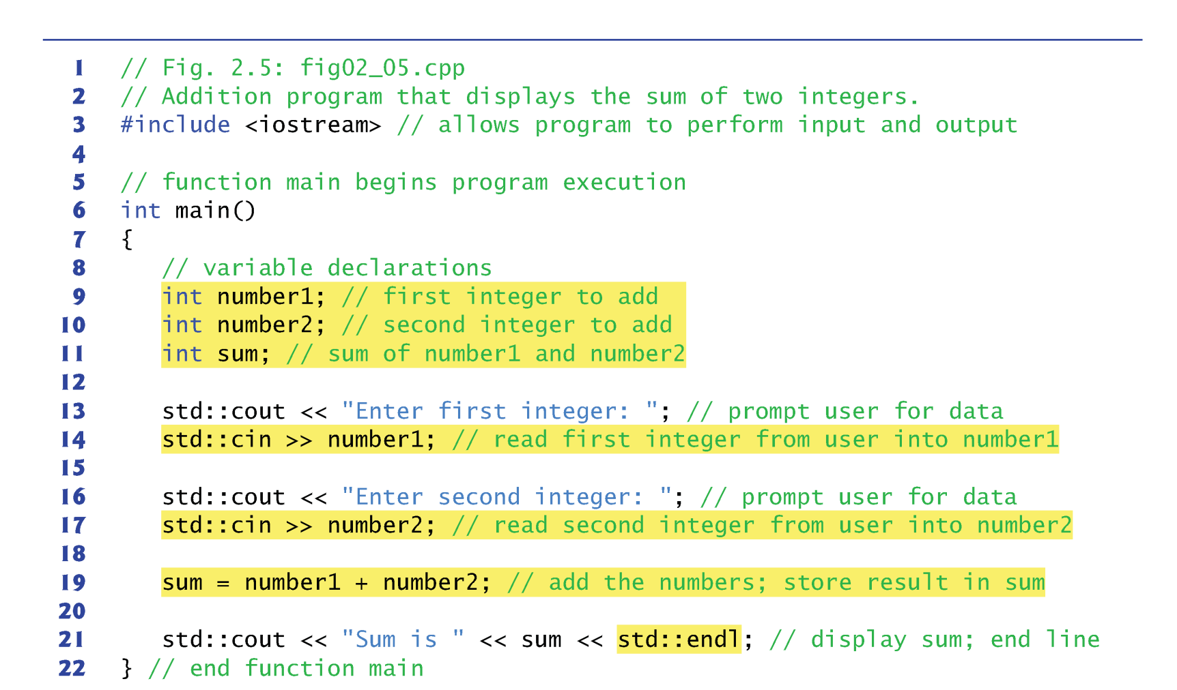
Adding Two Integers
// Comments starts with //
Notes:
Last time we ended with this example of adding two integers. The program asks you to type in two integer numbers, number 1 and number 2 and the program sum the result and output it using cout. So here we use the keyword int to define three variables, number1, number2, and sum. Then we use cin to read the first integer from users into number1, the second integer from users into number2. We add the two numbers, and store result in sum. Finally, we use cout to display the value.

Slide 4
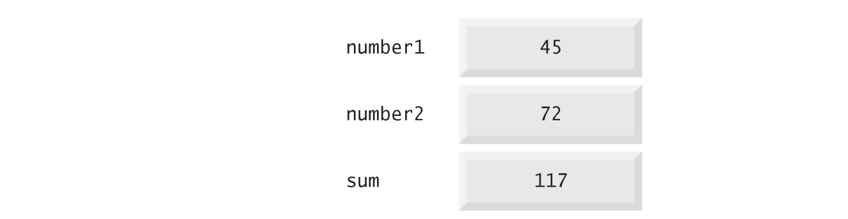
Memory Concepts
Variable names such as number1, number2 and sum actually correspond to locations in the computer’s memory.
Every variable has a name, a type, a size and a value.
When a value is placed in a memory location, it overwrites the previous value in that location → destructive
When a value is read out of a memory location, the process is nondestructive.
Notes:
Now we have seen a basic C++ program that takes two input number1 and number2 from the user, sum the two numbers, and store the result in a variable. It's important for us to know how this program actually works on hardware, or memory. Remember that in the first lecture, we talked about C++ is powerufl in mapping your program directly into hardware. One of the fundamental concepts is memory architecture of your data.
(explain each item ...)

Slide 5

Yes, Memory is Limited
You may not create too many variables
e.g. one trillion integers or more
This literally means your program can run up to 8 GB memory
Notes:
You probably already know, memory is limited. Yes, that means you may not create too many variables, for example, a trillion integers or more. The largest size of the program you can run on your machine depends on the memory size you have. You can get this information when you purchase a laptop or a desktop. For example, below I am showing you a 13 inch surface laptop that has 8GB memory. This literally means your program can run up to 8 GB memory.

Slide 6
Illustration
Memory
std::cout << "Enter first integer: ";
std::cin >> number1;
std::cout << "Enter second integer: ";
std::cin >> number2;
sum = number1 + number2;
std::cout << "Sum is " << sum << std::endl;
sum |  | 0012FF74
 |  | 0012FF75
 |  | 0012FF76
 |  | 0012FF77
number2 |  | 0012FF78
 |  | 0012FF79
 |  | 0012FF7A
 |  | 0012FF7B
number1 |  | 0012FF7C
 |  | 0012FF7D
 |  | 0012FF7E
 |  | 0012FF7F
Output
Notes:
To give you a better idea about how this simple program works on hardware, let's illustrate the runtime. Here I have the program that takes two inputs and sums their values to an output. On the right-hand side, I have the memory with variable name on the left and their virtual address from byte to byte on the right side. Remember each integer is indeed a 32-bit data, that is 4 bytes, because each byte has 8 bits.
Let's run the program.

Slide 7
Illustration
std::cout << "Enter first integer: ";
std::cin >> number1;
std::cout << "Enter second integer: ";
std::cin >> number2;
sum = number1 + number2;
std::cout << "Sum is " << sum << std::endl;
Memory
sum |  | 0012FF74
 |  | 0012FF75
 |  | 0012FF76
 |  | 0012FF77
number2 |  | 0012FF78
 |  | 0012FF79
 |  | 0012FF7A
 |  | 0012FF7B
number1 |  | 0012FF7C
 |  | 0012FF7D
 |  | 0012FF7E
 |  | 0012FF7F
Output
Enter first integer: _

Slide 8
Illustration
Memory
std::cout << "Enter first integer: ";
std::cin >> number1;
std::cout << "Enter second integer: ";
std::cin >> number2;
sum = number1 + number2;
std::cout << "Sum is " << sum << std::endl;
sum |  | 0012FF74
 |  | 0012FF75
 |  | 0012FF76
 |  | 0012FF77
number2 |  | 0012FF78
 |  | 0012FF79
 |  | 0012FF7A
 |  | 0012FF7B
number1 |  | 0012FF7C
 |  | 0012FF7D
 |  | 0012FF7E
 |  | 0012FF7F
Output
Enter first integer: 45_

Slide 9
Illustration
std::cout << "Enter first integer: ";
std::cin >> number1;
std::cout << "Enter second integer: ";
std::cin >> number2;
sum = number1 + number2;
std::cout << "Sum is " << sum << std::endl;
Memory
sum |  | 0012FF74
 |  | 0012FF75
 |  | 0012FF76
 |  | 0012FF77
number2 |  | 0012FF78
 |  | 0012FF79
 |  | 0012FF7A
 |  | 0012FF7B
number1 | 45 | 0012FF7C
 |  | 0012FF7D
 |  | 0012FF7E
 |  | 0012FF7F
Output
Enter first integer: 45
_

Slide 10
Illustration
Memory
std::cout << "Enter first integer: ";
std::cin >> number1;
std::cout << "Enter second integer: ";
std::cin >> number2;
sum = number1 + number2;
std::cout << "Sum is " << sum << std::endl;
sum |  | 0012FF74
 |  | 0012FF75
 |  | 0012FF76
 |  | 0012FF77
number2 |  | 0012FF78
 |  | 0012FF79
 |  | 0012FF7A
 |  | 0012FF7B
number1 | 45 | 0012FF7C
 |  | 0012FF7D
 |  | 0012FF7E
 |  | 0012FF7F
Output
Enter first integer: 45
Enter second integer: _

Slide 11
Illustration
Memory
std::cout << "Enter first integer: ";
std::cin >> number1;
std::cout << "Enter second integer: ";
std::cin >> number2;
sum = number1 + number2;
std::cout << "Sum is " << sum << std::endl;
sum |  | 0012FF74
 |  | 0012FF75
 |  | 0012FF76
 |  | 0012FF77
number2 |  | 0012FF78
 |  | 0012FF79
 |  | 0012FF7A
 |  | 0012FF7B
number1 | 45 | 0012FF7C
 |  | 0012FF7D
 |  | 0012FF7E
 |  | 0012FF7F
Output
Enter first integer: 45
Enter second integer: 72_

Slide 12
Illustration
std::cout << "Enter first integer: ";
std::cin >> number1;
std::cout << "Enter second integer: ";
std::cin >> number2;
sum = number1 + number2;
std::cout << "Sum is " << sum << std::endl;
Memory
sum |  | 0012FF74
 |  | 0012FF75
 |  | 0012FF76
 |  | 0012FF77
number2 | 72 | 0012FF78
 |  | 0012FF79
 |  | 0012FF7A
 |  | 0012FF7B
number1 | 45 | 0012FF7C
 |  | 0012FF7D
 |  | 0012FF7E
 |  | 0012FF7F
Output
Enter first integer: 45
Enter second integer: 72
_

Slide 13
Illustration
std::cout << "Enter first integer: ";
std::cin >> number1;
std::cout << "Enter second integer: ";
std::cin >> number2;
sum = number1 + number2;
std::cout << "Sum is " << sum << std::endl;
Memory
sum | 117 | 0012FF74
 |  | 0012FF75
 |  | 0012FF76
 |  | 0012FF77
number2 | 72 | 0012FF78
 |  | 0012FF79
 |  | 0012FF7A
 |  | 0012FF7B
number1 | 45 | 0012FF7C
 |  | 0012FF7D
 |  | 0012FF7E
 |  | 0012FF7F
Output
Enter first integer: 45
Enter second integer: 72
_

Slide 14
Illustration
Memory
std::cout << "Enter first integer: ";
std::cin >> number1;
std::cout << "Enter second integer: ";
std::cin >> number2;
sum = number1 + number2;
std::cout << "Sum is " << sum << std::endl;
sum | 117 | 0012FF74
 |  | 0012FF75
 |  | 0012FF76
 |  | 0012FF77
number2 | 72 | 0012FF78
 |  | 0012FF79
 |  | 0012FF7A
 |  | 0012FF7B
number1 | 45 | 0012FF7C
 |  | 0012FF7D
 |  | 0012FF7E
 |  | 0012FF7F
Output
Enter first integer: 45
Enter second integer: 72
Sum is 117_

Slide 15
Illustration
Memory
std::cout << "Enter first integer: ";
std::cin >> number1;
std::cout << "Enter second integer: ";
std::cin >> number2;
sum = number1 + number2;
std::cout << "Sum is " << sum << std::endl;
sum | 117 | 0012FF74
 |  | 0012FF75
 |  | 0012FF76
 |  | 0012FF77
number2 | 72 | 0012FF78
 |  | 0012FF79
 |  | 0012FF7A
 |  | 0012FF7B
number1 | 45 | 0012FF7C
 |  | 0012FF7D
 |  | 0012FF7E
 |  | 0012FF7F
Output
Enter first integer: 45
Enter second integer: 72
Sum is 117
Press any key to continue_

Slide 16
binary representation | hexadecimal | decimal
00000000 00000000 00000000 00000000 | 00000000 | 0
00000000 00000000 00000000 00000001 | 00000001 | 1
00000000 00000000 00000000 00000010 | 00000002 | 2
00000000 00000000 00000000 00000011 | 00000003 | 3
00000000 00000000 00000000 00000100 | 00000004 | 4
00000000 00000000 00000000 00000101 | 00000005 | 5
00000000 00000000 00000000 00000110 | 00000006 | 6
00000000 00000000 00000000 00000111 | 00000007 | 7
00000000 00000000 00000000 00001000 | 00000008 | 8
00000000 00000000 00000000 00001001 | 00000009 | 9
00000000 00000000 00000000 00001010 | 0000000A | 10
00000000 00000000 00000000 00001011 | 0000000B | 11
00000000 00000000 00000000 00001100 | 0000000C | 12
00000000 00000000 00000000 00001101 | 0000000D | 13
00000000 00000000 00000000 00001110 | 0000000E | 14
00000000 00000000 00000000 00001111 | 0000000F | 15
Notes:
This slide sows the binary representation and hexadecimal representation of the address, and their corresponding decimal value. Keep in mind, it is very common to use binary representation and hexadecimal representation in computer rather than decimal representation that we are all familiar with.

Slide 17
Value Representation
Binary, Octal, Decimal, Hex
The six letters (in addition to the 10 integers) in hexadecimal represent: 10 (A), 11 (B), 12 (C), 13 (D), 14 (E), and 15 (F), respectively.
Name | Radix | Digits
Binary | 2 | 0,1
Octal | 8 | 0,1,2,3,4,5,6,7
Decimal | 10 | 0,1,2,3,4,5,6,7,8,9
Hexadecimal | 16 | 0,1,2,3,4,5,6,7,8,9,A,B,C,D,E,F
Notes:
There are many value representations, such as binary, octal, decimal, and hex. In the world of binary representation, the radix or base is two, and the total different numbers we can use is two, either zero or one. It's like in the decimal world, we have ten different digits to represent any numbers, 0, 1, 2, 3, 4, 5, 6, 7, 8, and 9. When we have a value larger than 9 we have a carry out to the next digit of the number.
In hexadecimal representation, in addition to the ten digits, 0, 1,2 ,3 ..., and have six letters, that represent 11, 12, 13, 14, and 15. and those letters are A, B, C, D, E, F. In other words, if you see a letter A, it means 10, if you see a letter B, it means 11, ... and so on.

Slide 18
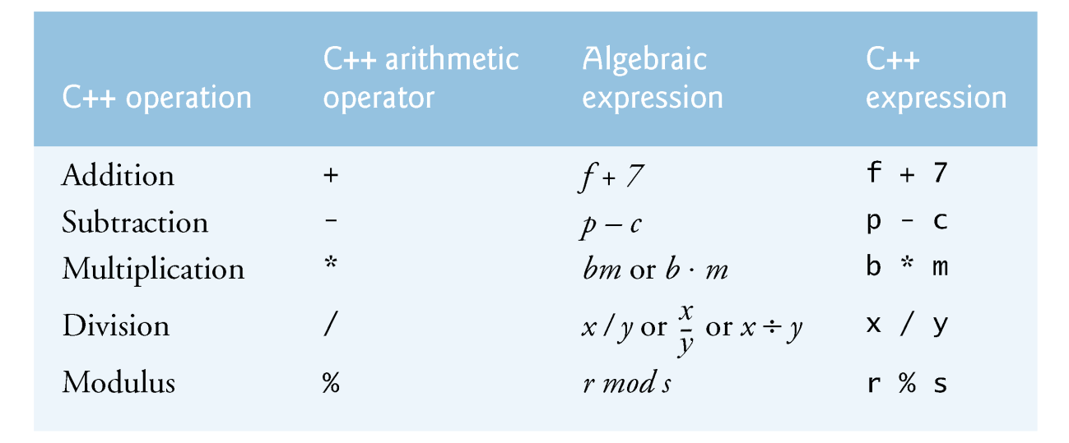
Common Arithmetic Operators
The arithmetic operators below are all binary operators.
Integer division yields an integer quotient.
Any fractional part in integer division is discarded (i.e., truncated) without rounding.
The percent sign (%) is the modulus operator.
The modulus operator provides the remainder after integer division.
The modulus operator can be used only with integer operands.
Notes:
We talked about the addition operation. Indeed, there are many more. In C++, we have subtraction that subtracts a number from another, multiplication that multiples a number by another, division that divide a number by another, and modulus operation that finds the remainder of a division, for example, if you divide 7 by 3, the remainder is 1.
The arithmetic operators below are common C++ operators and they are all binary operators. A binary operator takes two number, does some operations on the two numbers, and returns the result.

Slide 19
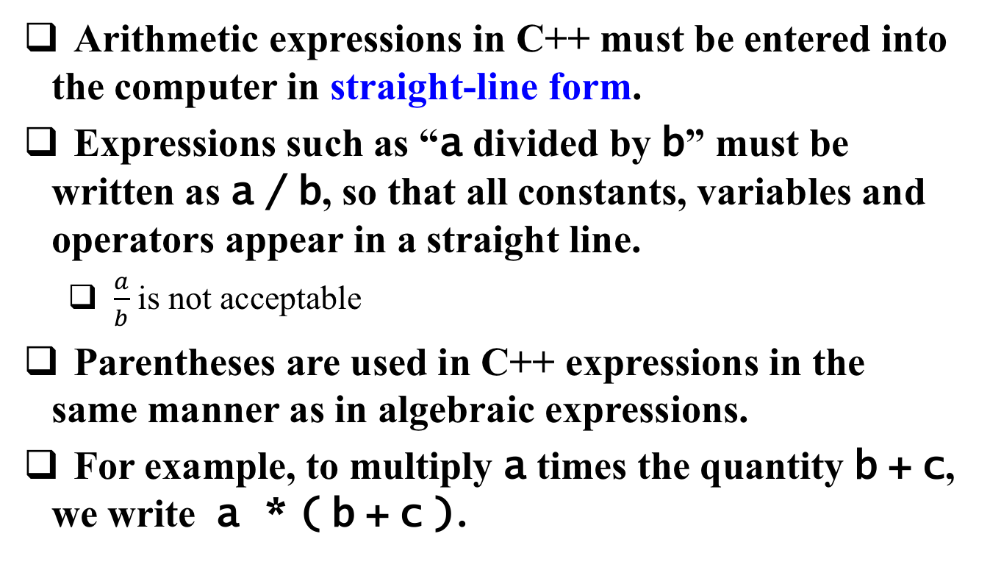
Writing Arithmetic Statement
Arithmetic expressions in C++ must be entered into the computer in straight-line form.
Expressions such as “a divided by b” must be written as a / b, so that all constants, variables and operators appear in a straight line.
$\frac{a}{b}$ is not acceptable
Parentheses are used in C++ expressions in the same manner as in algebraic expressions.
For example, to multiply a times the quantity b + c, we write a * ( b + c ).
Notes:
Arithmetic ... ; that means, we normally use one line to describe an arithmetic expression. Expression such as "a divided by b" ...

Slide 20
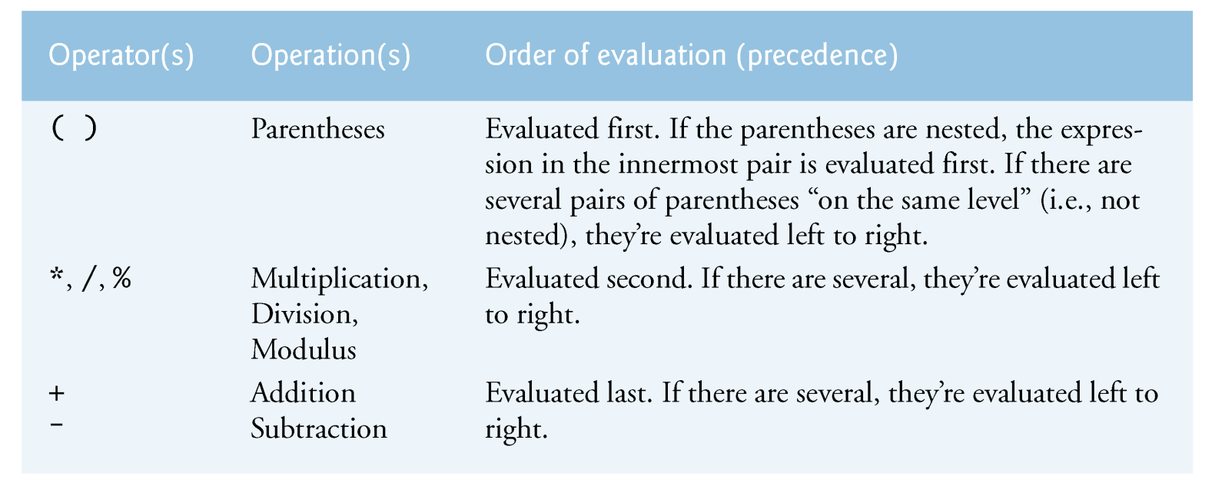
Operator Precedence
C++ applies the operators in arithmetic expressions in a precise sequence determined by the following rules of operator precedence, which are generally the same as those followed in algebra.
Notes:
Operator has precedence. Some operators are also evaluated before operators. A common example is the multiplication and division operators that always happen before plus and minus operators. This is essentially very similar to what you have learned from the high school. Say, if you write an expression, a + b * c, the multiplication b times c is evaluated before the addition +.
C++ applies the operators in ... (follow)

Slide 21
All Statements are Character by Character
There is no arithmetic operator for exponentiation in C++, so x² is represented as x * x.
As in algebra, it’s acceptable to add unnecessary parentheses to make the expression clearer.
x = (a / b) * c instead of x = a / b * c
y = a + (b/c) instead of x = a + b / c
These are called redundant parentheses.
Using redundant parentheses in complex arithmetic expressions can make the expressions clearer
Notes:
Keep in mind, all statements are written on a character basis. There is no ...

Slide 22
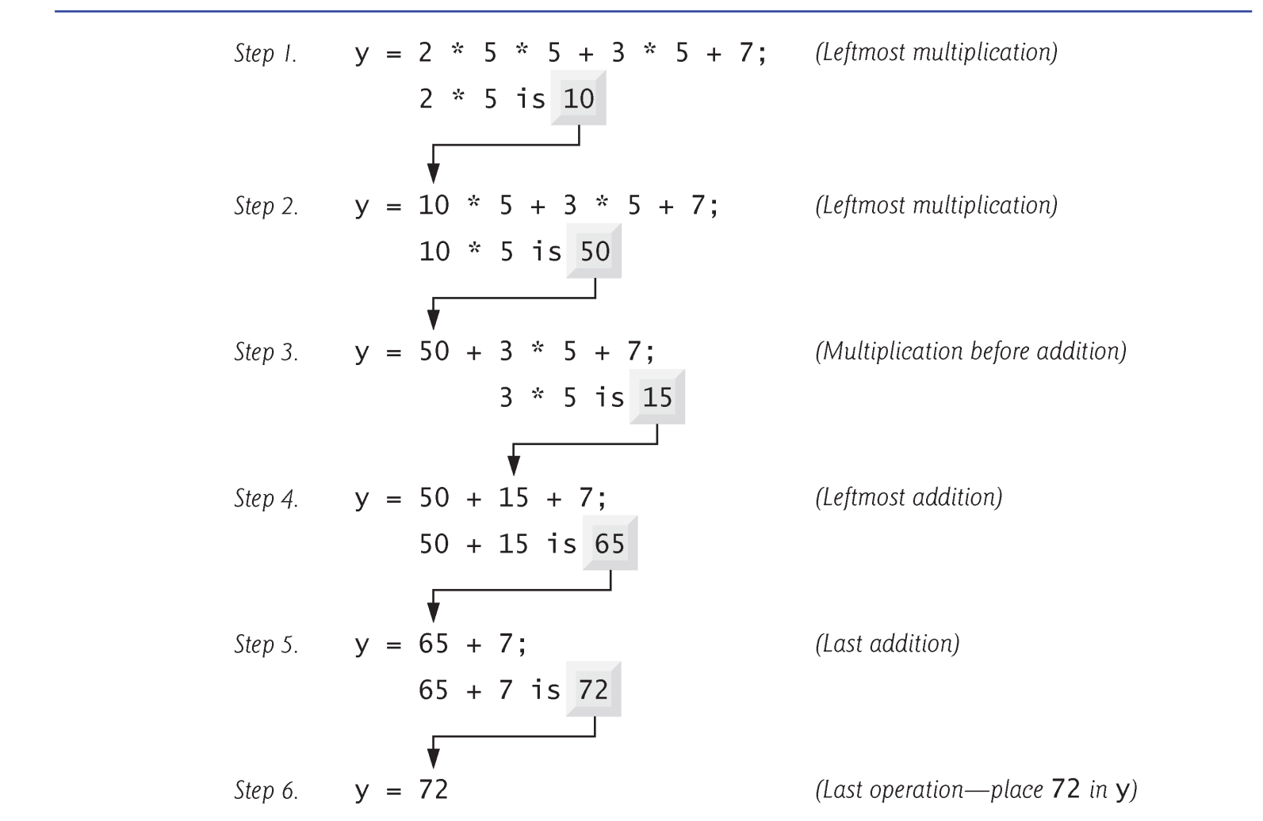
Example
y = ax² + bx + c
y=(a*x*x)+(b*x)+c;
a=2, b=3, c=7, x=5
Notes:
Let's look at one example. Here I have an expression y equals a x square plus b x plus c. Again, this is not an equation but an assignment. We assign ax square plus bx plus c to y. We compute the result of a x square plus bx plus c and stores it to y.
In terms of c++ statement, we will have a parenthesis for a x square, we write a * x times x, using the star sign to perform multiplication, then we have another parenthesis b times x and then use plus sign to sum up the result. What the computer program evaluates this expression is, first, we starts from the leftmost multiplication, 2 times 5 ...
Now, question for you. In this simple expression, if we remove parenthesis, will the result be correct?

Slide 23
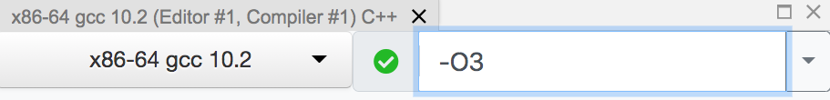
Practice
Evaluate the following expression and print the value of y, assuming all variables are integers
a = 2, b = 3, c = -5, d = 5, e = -12;
y = (a+b)(c-d) + e³ + 20
How many lines of assembly you see from compiler explorer? https://godbolt.org/
What about enabling optimization –O3?
Notes:
Let's do a practice, ...

Slide 24
Decision Making: Equality and Relational Operators
The if statement allows a program to take alternative action based on whether a condition is true or false.
If the condition is true, the statement in the body of the if statement is executed.
Otherwise, the body statement is not executed.
Conditions can be formed by using the equality operators and relational operators
The relational operators all have the same precedence level and associate left to right.
The precedence level of equality operators is lower than that of the relational operators. (association is still left to right)
Notes:
Let's move on to the next topic: Decision making using equality and relational operators. When you write programs, you always need to do some decision making or control flow. IF somethins happens, I will do A, or I will do another thing. If the weather is good, I will go outside or I will stay home. This is control flow, and control flow relies on decision making. C++ have multiple operators for you to make decisions. Here we are going to talk about two most commonly used decision making operators: Equality and relational operators.
(explain...)

Slide 25
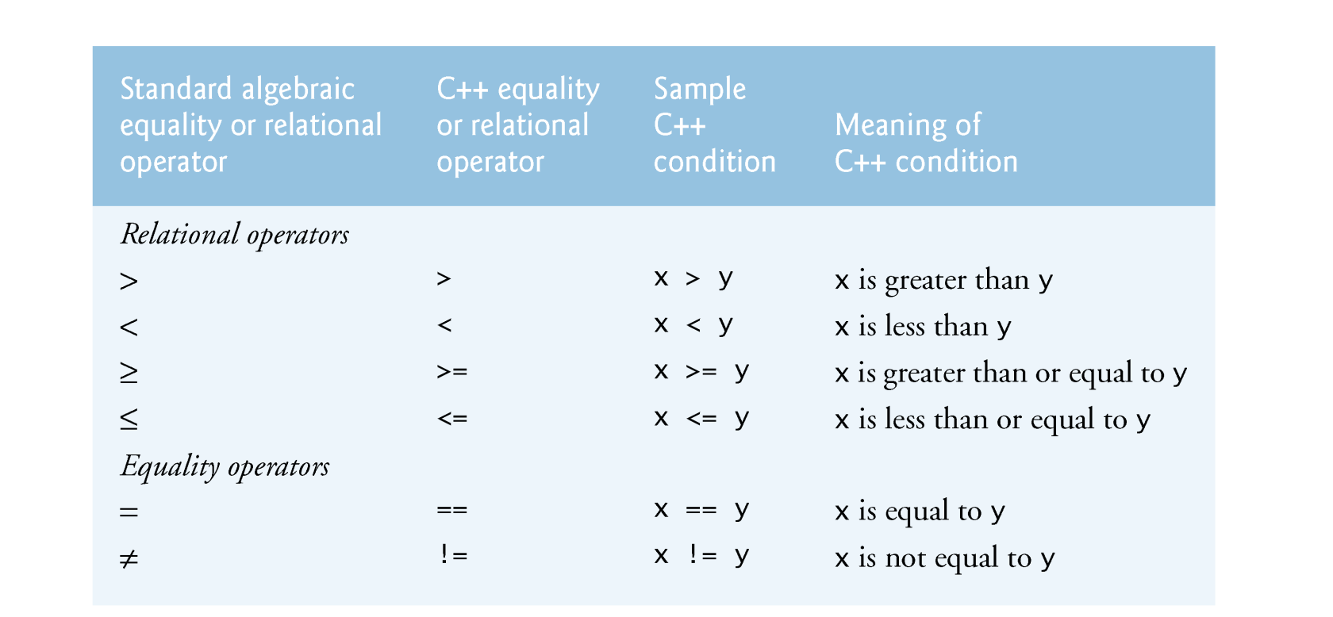
Decision Making: Equality and Relational Operators
Notes:
This slides show the equality and relational operators defined by C++. On the relational operator side, we have four operators. greater sign, less sign, ... ; greater sign is an operator that takes two numbers, say, x and y, and returns true if x is grater than y, or false otherwise. (explain ...
On the eauality operator side, we have two operators, double equal sign and not equal sign. (explain ...)

Slide 26
Equality operator “==“ vs Assignment “=“
Confusing the equality operator == with the assignment operator = results in logic errors!
The equality operator should be read “is equal to,” and the assignment operator should be read “gets” or “gets the value of” or “is assigning the value of .”
Some people prefer to read the equality operator as “double equals.”
Notes:
Do not confuse the euqality operator with assignment operator. One has two equal signs and the other has only a single equal sign.

Slide 27
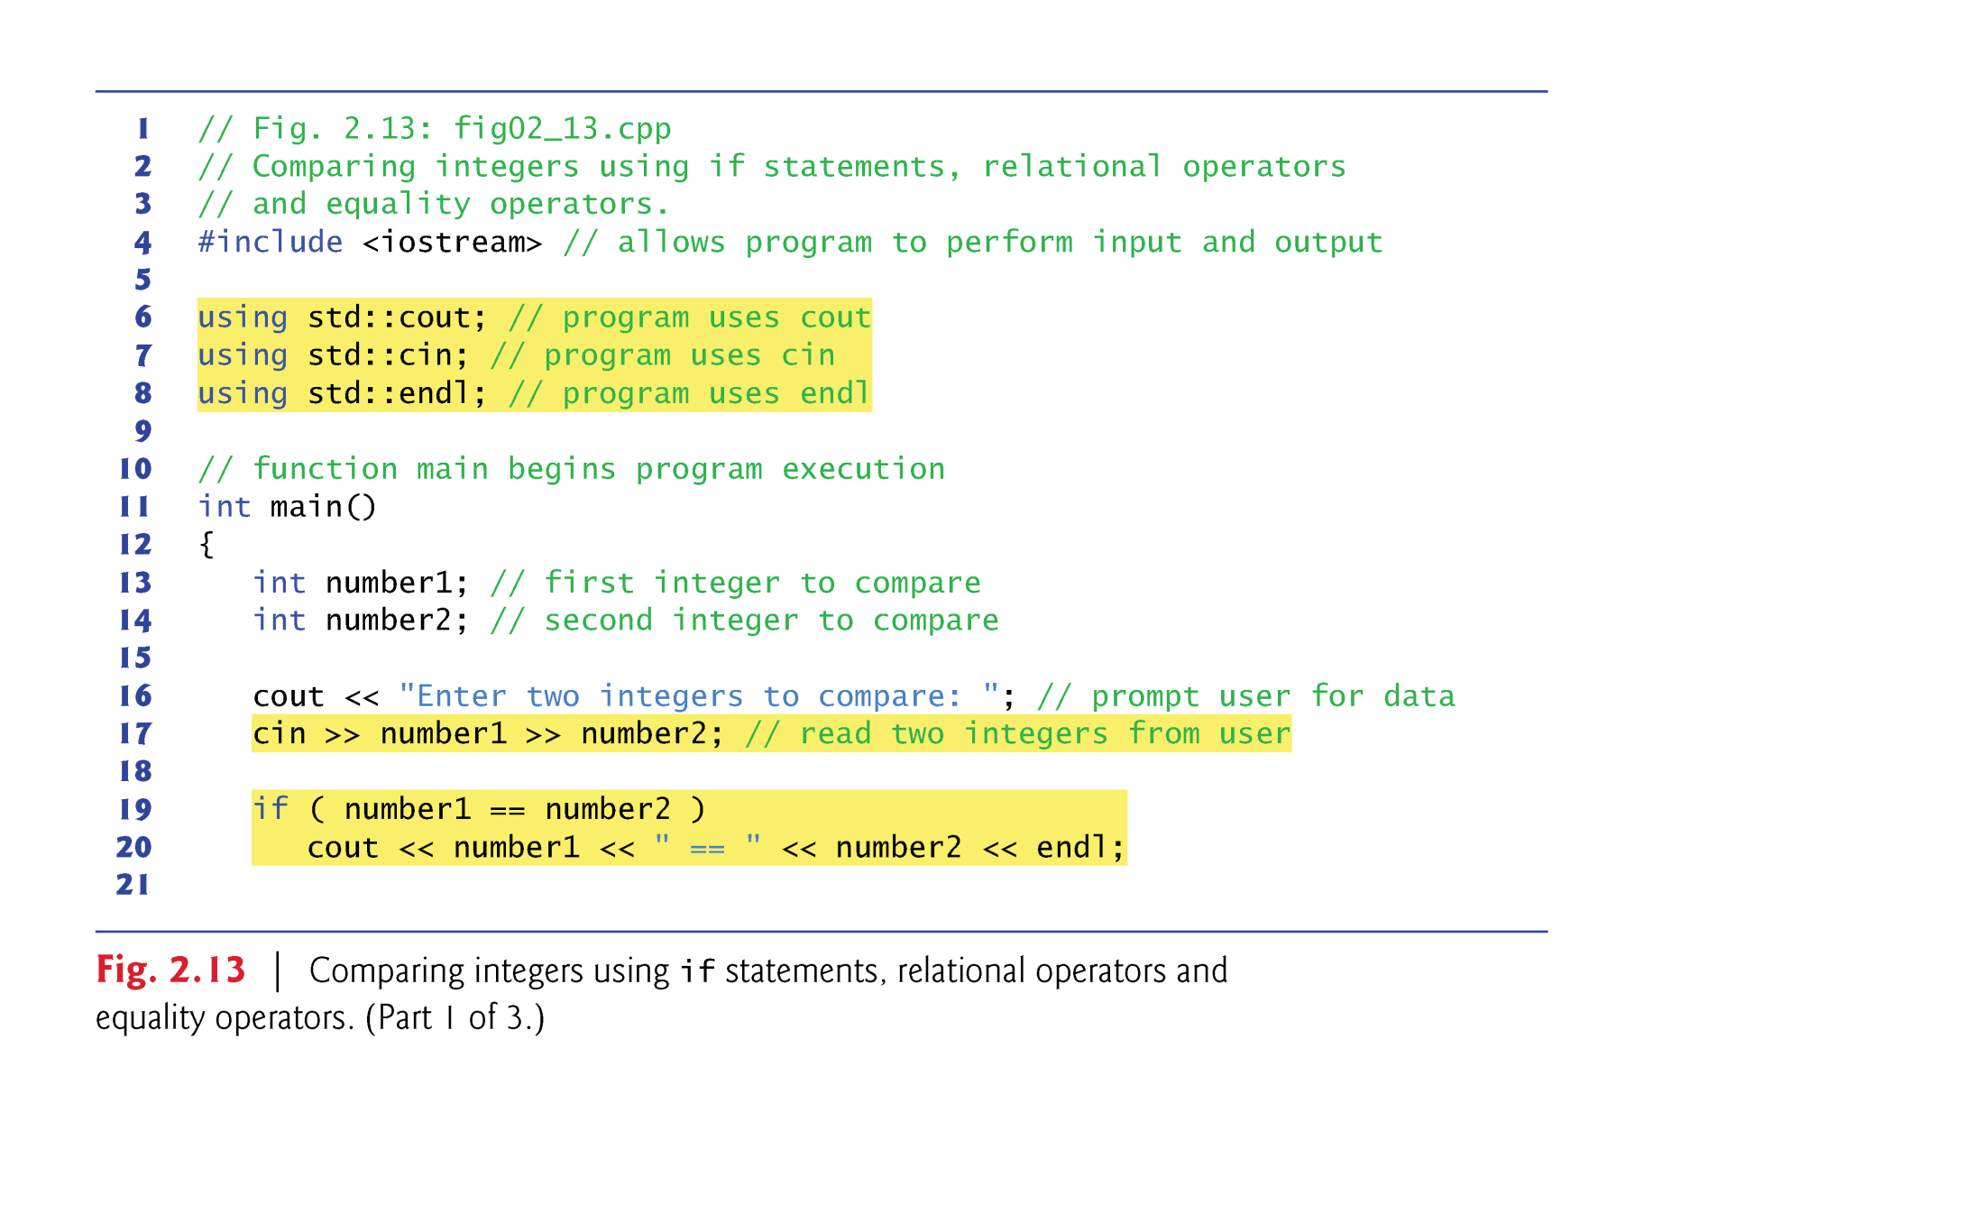
Example
Notes:
Let's take a look at an example. The example I am going to show you is a program that takes two integers and prints out their numerical relations using euqality oeprators and relational operators. (exampl ...)

Slide 28
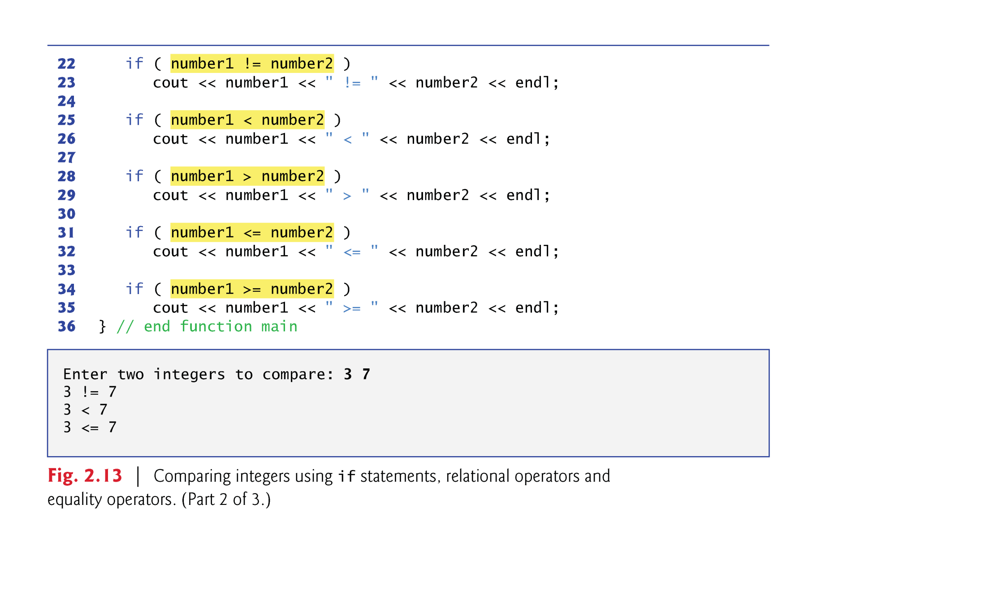
Example (cont’d)

Slide 29
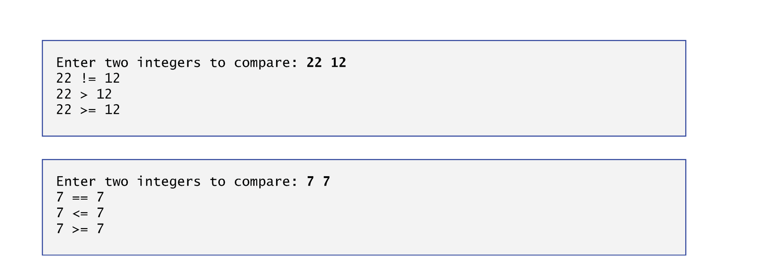
Example (cont’d)

Slide 30
Line-by-Line Debrief
After inserting the using declarations, we can write cout instead of std::cout in the remainder of the program.
std::cin → cin, std::endl → endl
Many programmers prefer to use the declaration
using namespace std;
which enables a program to use all the names in any standard C++ header file (such as <iostream>).
=> NEVER DO THIS (BAD BEHAVIOR)
Notes:
Let's do a line-by-line debrief. In the first three lines of the program, you probably notice that I define three statements to explicitly call out the use of cout, cin, and endl. Here I wrote using std::cout. What it does is, in the later program, whenever I use cin, I don't need to start with the namespace convention std::. I can directly use cin becuyase I explicitly speicify it in the very beginning.
Now, question for you, why is this a bad habbit?

Slide 31
Line-by-Line Debrief
This program uses cascaded stream extraction operations to input two integers.

Slide 32
Line-by-Line Debrief
Each if statement in our example has a single statement in its body and each body statement is indented.
For if statements with multiple-statement bodies, you need to enclose the body statements in a pair of braces, { }, creating what’s called a compound statement or a block).

Slide 33
Line-by-Line Debrief
Indent the statements in the body of an if statement to enhance readability
For readability, there should be no more than one statement per line in a program
Notes:
explain ...
This indent is really important for other people to read your code, and it is really important for the readability of your code. Everything that happens under the same decision-making logic is written with the same indent. This way, when people read your code, he or she knows what happens under which conditional logic so they can quickly scope their eyes to that block of the same indent.

Slide 34
Line-by-Line Debrief
Placing a semicolon immediately after the right parenthesis after the condition in an if statement is often a logic error (although not a syntax error). The semicolon causes the body of the if statement to be empty, so the if statement performs no action, regardless of whether or not its condition is true
if (number1 < number 2)
cout << number1 << “ < ” << number2;
if (number1 < number 2) ;
cout << number1 << “ < ” << number2;
Notes:
Placing ... (explain)

Slide 35
Line-by-line Debrief
Statements may be split over several lines and may be spaced according to your preferences.
It’s a syntax error to split identifiers, strings (such as "hello") and constants (such as the number 1000) over several lines.
cout << number1 << " < " << number2;
cout << number1
<< " < " << number2;

Slide 36
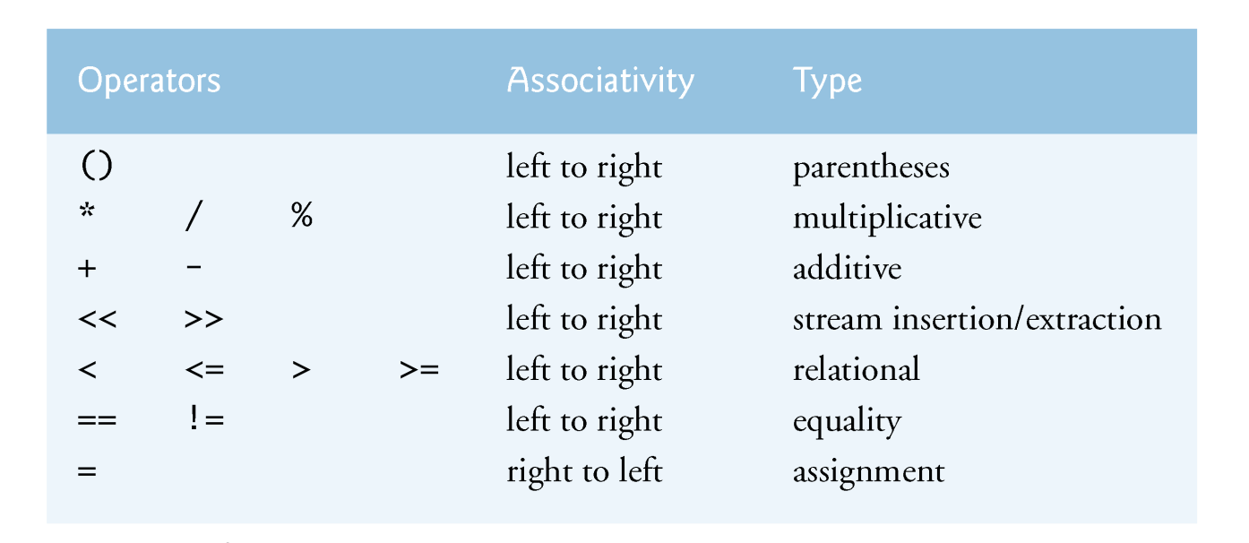
Decision-Making Operator Precedence
The operators are shown top to bottom in decreasing order of precedence.
All these operators, with the exception of the assignment operator =, associate from left to right.
Notes:
Again, relational operator has precedence. The operators are shown top to bottom in decreasing order of precedence. In general, you can see, the arithmetic operators take precedence over decision making operators, including equality operators and relational operators. This actually makes sense, because we want to perform arithmetic operators to find out the result first before we wanna compare them. For example, I want to find out the result of x and y and do comparison. So, the arithmetic operators happen or are evaluated before decision-making operators.
All these operators, with the exception of the assignment operator =, associate from left to right.

Slide 37
Summary
C++ input and output
Arithmetic expression
Binary operators, +, -, *, /
Operator precedence (e.g., * precede +)
Conditionals
Equality operator ==, !=
Relational operator <=, <, >, >=
Notes:
u1306576@umail.utah.edu;u1100840@utah.edu;u1231201@utah.edu;u1059119@utah.edu;u1277271@utah.edu;u1279042@utah.edu;u1288871@utah.edu;u1162987@utah.edu;u1149181@utah.edu;u1034348@utah.edu;u1274730@utah.edu;u1309216@utah.edu;u1307344@utah.edu;u1054050@utah.edu;u0906668@utah.edu;u1020513@utah.edu;u1046844@utah.edu;u0934438@utah.edu;u1028034@utah.edu;u1218276@utah.edu;u1205315@utah.edu;u1235021@utah.edu;u0613876@utah.edu;u1194598@utah.edu;u0800167@utah.edu;u1100383@utah.edu;u1313270@utah.edu;u1170639@utah.edu;u1233102@utah.edu;u0441877@utah.edu;u1306569@utah.edu;u1117469@utah.edu;u1053605@utah.edu;u1186007@utah.edu;u1117512@utah.edu;u1015229@utah.edu;u1322203@utah.edu;u1030352@utah.edu;u1030406@utah.edu;u1298265@utah.edu;u1309248@utah.edu;u1134903@utah.edu;u1080280@utah.edu;u1184264@utah.edu;u1255151@utah.edu;u0726957@utah.edu;u1174177@utah.edu;u1165266@utah.edu;u1201859@utah.edu;u1169721@utah.edu;u1337151@utah.edu;u1025911@utah.edu;u1307883@utah.edu;

